Slide 1

MSDS670– Final Project
Erin Kane
Koenig
25 June 2023

Slide 2
Situation
Using the superstore.csv dataset which features Orders, Ship Dates, Customer ID, Region, Category, etc... to create visuals that display in histogram, heatmap, and choropleth models.

Slide 3

Research Questions
Which state of US has higher frequency of sales?
In which year were had max sales?
In which month we have max sales?
Which days of the month yield higher sales?
What are the top 15 states with high sales?
What are the top 15 cities with high sales?
Top products highly in demand?
Most frequent customers?

Slide 4
Data
The Dataset
19 Features – only focusing on:
  Frequency of Sales
  Day, month, year of Max Sales
  Top 15 states
  Top 15 cities
  Top product
  Top Customer
9994 entries
No missing values
Original sources from Tableau

Slide 5
Methodology
Installed Necessary Libraries
Worked Exploratory Data Analysis
numpy, pandas, matplotlib, seaborn, plotly, and statsmodels
Identified features, shape, description, located missing values
Evaluated for Correlations
Started to Answer Questions with Visuals
Use Heatmap to locate correlations in the dataset
Began manipulating the dataset to find answers and produce visuals

Slide 6
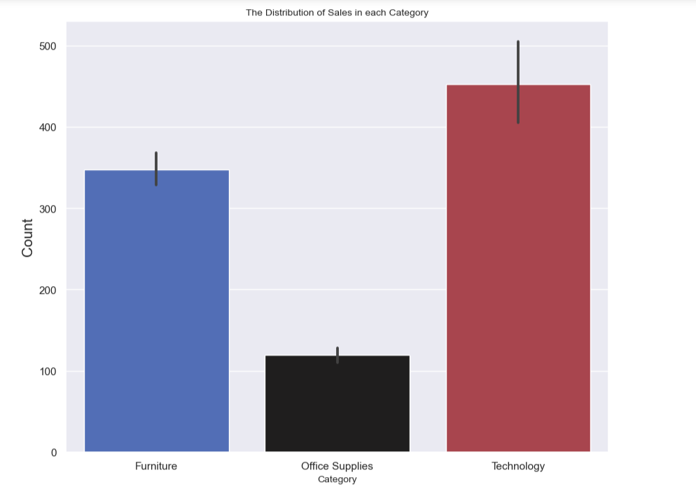
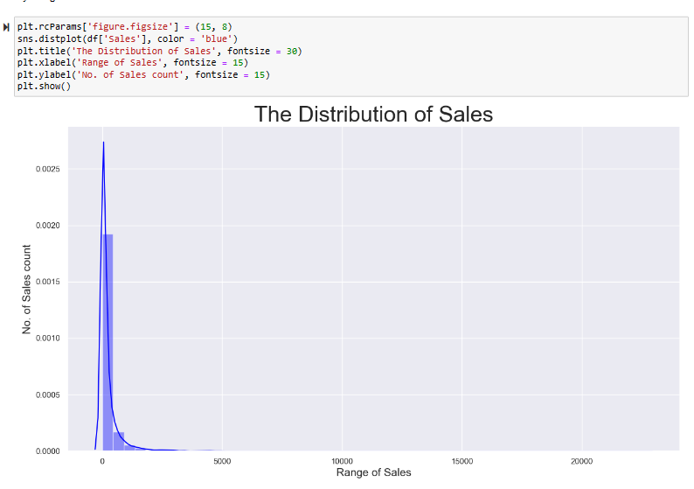
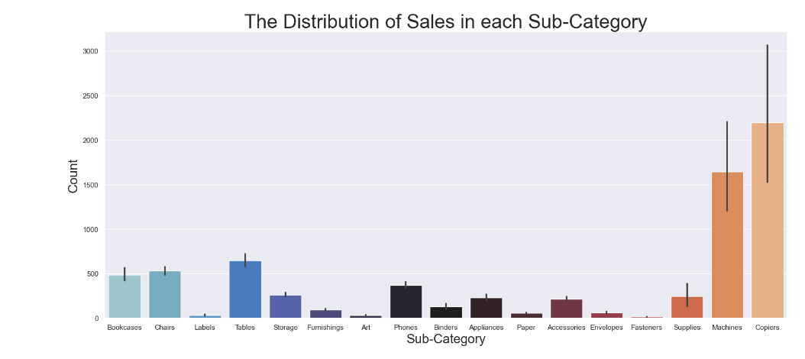
Results

Slide 7
Conclusion
In summary, the Superstore.csv dataset was a fantastic dataset to work with, and it allowed me to practice my work in visualizations. I could identify and find all the answers to my questions, work with Matplotlib, and plotly to provide exciting and relevant information displayed in heatmaps, bar plots, and choropleth models.

Slide 8
References
Seaborn heatmap color templates.
https://seaborn.pydata.org/generated/seaborn.heatmap.html
https://pythonbasics.org/seaborn-heatmap/

